Slide 1
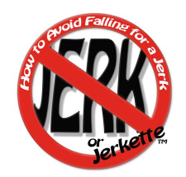
Progression of romantic relationships/How to avoid falling in love with a jerk.
Meeting each
First and Third Monday of every month
7:00 PM until completed
Presenter:
Larry Epstein LMHC CASAC

Slide 2
This session will be a 2 part discussion. First I will describe what a “typical” American romantic relationship will look like. There are natural stages a relationship goes through that are normal and expected from when we meet someone to “getting old and grey together.”
Then I will discuss in closer detail the first 3 months of a romantic relationship using the book “How to Avoid Falling in Love with a Jerk” by John Van Epp Ph D. His work highlights the pitfalls of becoming physically intimate with another person before certain criteria are met. A flaw that biologically makes perfect sense, but culturally is counterproductive and potentially destructive.

Slide 3
What is a Romantic Love?
From the textbook “Life-span Development” 6th ed.
Also called passionate love, or eros, romantic love has strong sexual and infatuation components and often predominates in the early period of a love relationship. Page G-8

Slide 4
What are the stages a relationship endures?
Not every relationship makes it through all these stages, but should a couple endure “until they are old an gray” chances are they will be able to reflect on these stages.
There is no guaranteed time frame a couple will remain in any one stage. Just like the stages of grief, some may last longer than others, and sometimes one may re-experience it.

Slide 5
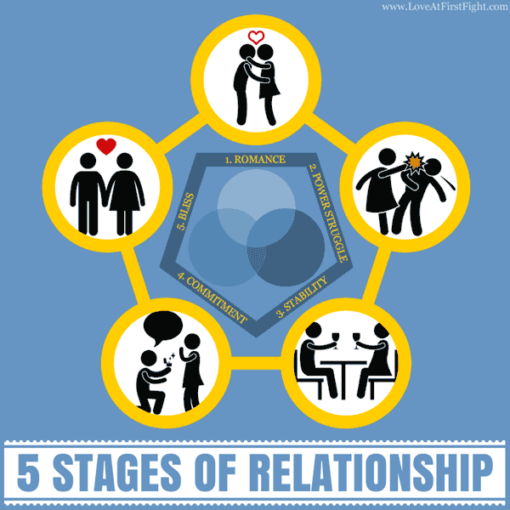
Stage 1: Romance
This “Romance” is a biological imperative. We find another person attractive. Biologically it signifies the desire to mate. We see features, a figure, eyes, humor, anatomy, and so on, interesting and it increases the idea that one will want to get to know another better. It also explains the “one night stand.”

Slide 6
Romance (continued)
In an order to perpetuate the species, we have to see something in another person that makes us attracted to him or her. Essentially, the unconscious motivation in this phase is “I want to make babies.”
Think about some of the “symptoms” of this phase:
I can’t sleep
I can’t get them out of my mind
Everything about him or her is perfect!
I can’t wait to see them!
I want to spend all my time with him or her.

Slide 7
Stage 2. Power Struggle
Depending on the couple, this starts at about 3 months. It is defined by negotiating the boundaries of the relationship. Does one person need to re-establish their independence? How about not spending Every moment texting. One remembers their other obligations.

Slide 8
Power Struggle (continued)
The things that drew you together “I like the way she snorts when she laughs” or “He’s so dedicated to his job, I just love that” now start to need some “negotiations.”
What was once cute and sweet may turn to annoying. The “blemishes” that everyone but you may have noticed (my friends warned me in the beginning, but I didn’t see it) start to become problematic.
The sex drive starts to fade and the need for a suitable companion that can play by your rules defines this stage.

Slide 9
Stage 3. Stability
This usually starts anywhere from 6-12 months into a relationship and lasts until the next phase which starts at around 2 years.
You’ve learned how you two fight, what’s acceptable boundaries, you make time for each other and its at this point you start introducing each other to peers and family.

Slide 10
Stage 3. Stability (continued)
This is the point where “you and I” becomes “we.” Habits are established, traditions may begin, celebrations and events are more likely to be conducted as a couple.
It is in this stage where the idea of “thinking about the future” comes into play. One may start thinking “does this person have long-term potential?

Slide 11
Stage 4. Commitment
This is when one “pops the question.” By today’s metrics, this may not happen. Marriage in the US is on the decline as an institution, but that doesn’t mean commitment necessarily is.
Couples may be in long-term commitments such as cohabitation, co-parenting, and remaining married and committed in every other sense of the word.

Slide 12
Stage 4. Commitment(continued)
This stage starts at about 2 years. Not every marriage starts in the commitment stage, but research has show that if you want the best chances of your relationship to last, you should probably wait this long to consider taking the step into marriage.
Why this long? Two years is a lot of time to get over the initial “infatuation” of stage 1, to learn about your partner’s pros and cons and decide is you can live with them, negotiate the rules of the relationship and have had 2 years worth of experiences to know if this person is “right for you.”

Slide 13
Level 5. Bliss/Co-Creation stage.
Once a couple is committed to one another, either by marriage or behavior (preferably both), they enter this stage which, in theory, remains in effect until separation, either by choice or by circumstance. The couple is a unit with one goal, the other’s happiness and satisfaction. The goal is to live a life together.

Slide 14
Level 5. Bliss/Co-Creation stage. (continued)
This stage is not permanent. Though it may be the “final” stage of a relationship, a couple may revert back to the “power struggle” stage occasionally, frequently, or normally. As people get older their needs change. For a couple to grow together there will probably be a constant need to negotiate the boundaries of the relationship.
When we hear the phrase “marriage/relationships is/are work”, this is a lot of what that means. It is not a bad thing but a normal part of a long-term relationship and not a sign of failure.

Slide 15
Defining a “Jerk.”
You probably saw the title of this powerpoint and thought to yourself “I don’t want to fall in love with jerks any longer, when will you start talking about them and how I can stop meeting them!
Good point, it’s about time I address that. In the context of relationships, a Jerk has a specific meaning.

Slide 16
Jerks…Continued.
To understand the “Jerk” as defined by Dr. Van Epps, the concept of what the progression of a “normal’ relationship looks like.
As mentioned earlier, the first stage is the “romance” stage. Some people refer to it as the “infatuation” stage because the other person is just so perfect. No flaws, he or she is everything you ever dreamed of.
But this was so in your last relationship, and the one before that, and the one before that. And look how They turned out (he said with sarcasm). If only you saw who they really were back then.

Slide 17
Jerks…Continued
When it was mentioned before that this stage was “biological” what that means is that the unconscious motivation at this stage is sex/making babies. It doesn’t matter if the couple for whatever reason is incapable of this. We are Attracted to the other person, and that is a function of biology. “you have traits I want to pass on to my children.”

Slide 18
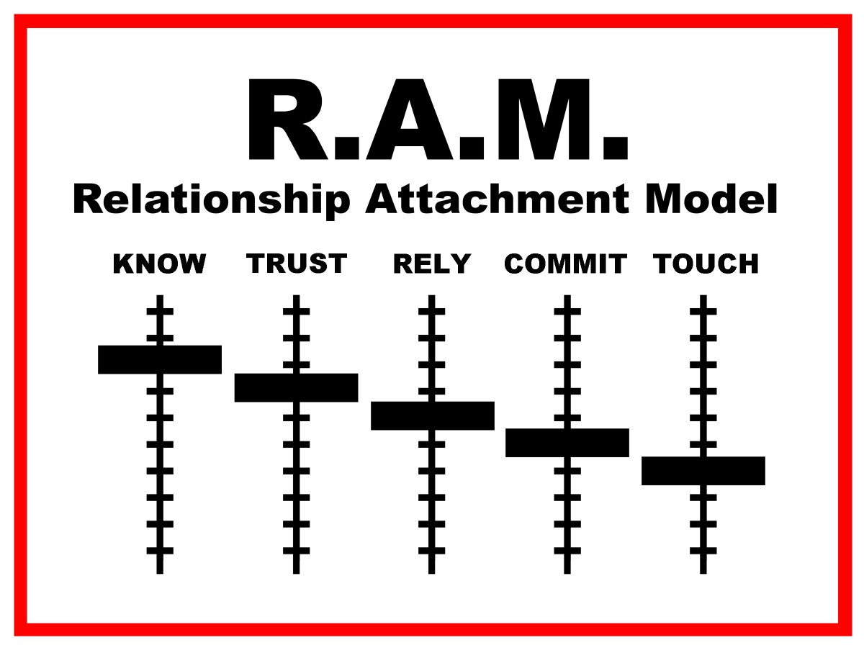
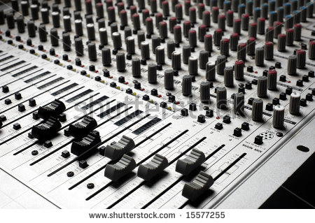
How the book, “How to Avoid Falling in Love with a Jerk” works.
The diagram on the right is designed to look like the “risers” or “sliders” you see on a mixing board in a studio.

Slide 19
The R.A.M.
In a healthy relationship, the “riser” on the left should always be at least a little higher than the riser to the right of it.
Know- The ability for one to say “I know this person well. Subjective to the individual as are all the categories.
Trust- To ability to be comfortable in the other person’s presence and with his or her character.
Rely- To feel comfortable in the affirmation that the other person has your best interests at heart.
Commit- The feeling or belief that the two individuals are united.

Slide 20
Touch
The last riser is “touch.” This may mean different things to different people, but in the context of this book, it means sexual behaviors. If you are unsure if a behavior is “Sexual” in nature, ask yourself “what would my mom think about this behavior.” If your conclusion is “Sex”, it probably is.
When your R.A.M looks like the diagram you saw 2 slides ago, you probably have moved out of the “romance” stage and into at least the Power struggle stage (usually around 3 months into a relationship).

Slide 21
Healthy R.A.M.
When you can say you know someone more than you trust them, when you trust them more than you can rely on them, why you can rely on them more than you are committed to the, then touch (sexual behaviors) is OK
Consider the circumstances. In the first 3 months of a relationship we are biologically driven. No matter how much you “click” no matter how “perfect” she is, no matter how much he “understands” you, you don’t really know each other well, can can’t fully trust him or her (and if you think you can, lend them a large sum of money and find out the hard way), you can’t rely on them, and you are not commited yet.

Slide 22
It takes 3 months minimally
To really know a person’s flaws, patterns, quirks, and to be able to say “yeah, I think I know them by now” you need at least 3 months. It could be argued one never Really knows another person, but after three months, most people can comfortably say they have enough knowledge that they do.
Prior to 3 months a behavior may be overlooked or excused, and a bad habit may just be an anomaly since we are not sure. And like everyone else, in those first 3 months, I’m trying to present the best version of myself, free of warts, pimples, odors, reprehensible quirks, and my potential mate only gets to see the best version of me.

Slide 23
So who is a “jerk”
A jerk is someone who either intentionally or otherwise pressures or insists on sexual behaviors prior to the 3 month timeframe. Without knowing, trusting, relying or being committed to another, one doesn’t know what to expect from another.
We all think that “this person is special” that they are “not like the others” and that being sexually active prior to knowing someone can be “just what we need to lay the foundation for a strong relationship.” Is that possible, yes. Is that likely, what does your experience say?

