Slide 1
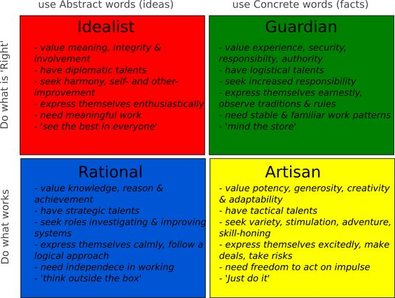
Keirsey’s Temperaments
Meeting each
First and Third Monday of every month
7:00 PM until completed
Presenter:
Larry Epstein LMHC CASAC

Slide 2
Dating back to ancient times, humans have tried to sort itself out by different types of people. We all have met someone who “reminds me of this person I know.” Are there really only so many types of people? Dating back to the Greek 4 fundamental personality types (sanguine choleric, melancholic, and phlegmatic) which were based on the idea that a person has too much of one type of body fluid, humanity has tried to understand what makes people tick.
There are a multitude of personality sorters, scales, measurement tools and assessments to choose from. The Keirsey Temperament sorter is a free tool found at www.Keirsey.com. It is based on the Meyer’s-Briggs Type indicator. The later is a ridged, 500+ questionnaire that will give a person a 4 category description of who they are, placing them into one of 16 personality types.

Slide 3
The Keirsey Temperament sorter (cont)
The Keirsey is 72 yes or no questions that will give you the same 4 category breakdown. It is not used to assess for maladaptive behavior nor dysfunction. Instead it is used to help one better understand why they do what they do and normalize one’s experiences in a world that, regardless of one’s temperament, puts them in the minority. No matter your temperament, there are more people in the world who are not your temperament.

Slide 4
Defining Temperament.
From http://keirsey.com/4temps/overview_temperaments.asp
Temperament is a configuration of observable personality traits, such as habits of communication, patterns of action, and sets of characteristic attitudes, values, and talents. It also encompasses personal needs, the kinds of contributions that individuals make in the workplace, and the roles they play in society. Dr. David Keirsey has identified mankind's four basic temperaments as the Artisan, the Guardian, the Rational, and the Idealist.
Each temperament has its own unique qualities and shortcomings, strengths and challenges.

Slide 5
A word on temperaments
No one temperament is better than another. No on puts you at an advantage or disadvantage. But each one has it’s pros and cons depending on the situation one finds him or herself in. The pros of one temperament can be the worst traits to have in the wrong situation.
They can change over time under the right or wrong circumstances.
They are not an excuse for behavior.
They will be presented in no particular order.

Slide 6
Another word on temperaments
In each temperament you will see 4 types associated with it. AN example is how NFs (intuitive feelers) consist of INFP, INFJ, ENFP and ENFJ. I will not be discussing the differences between the four MBTI types, only how the NFs (a temperament) differs from the NTs, SPs and SJs.
For a more detailed explanation of the 16 types, I recommend looking into the Meyer’s Briggs type indicator.

Slide 7
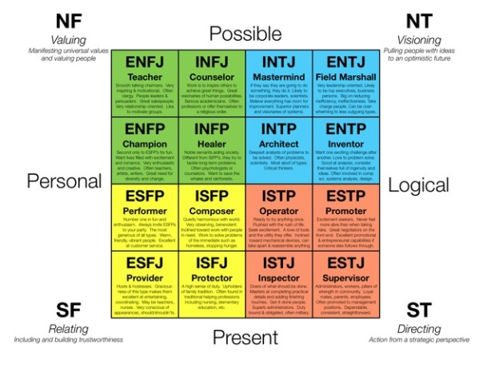
The NFs (Intuitive Feelers)
The NFs or “Idealists” are motivated by the search for self discovery and being genuine to one’s own self.
They do not conform well to other’s ideals. Not out of a sense of rebellion, but out of a sense of authenticity to themselves
They consist of about %17-%18 of the population of the US.

Slide 8
Idealists (cont)
They tend to go into either expressive, creative, or helping professions. They value feelings over thoughts, going with what feels right, talking things out, and don’t care much if what they are doing is approved by the masses.
How they are viewed by the other 3 temperaments:
Moody
Self-absorbed
Naïve
Flaky
Their opposite: The NTs (Rationals)

Slide 9
The NTs (Intuitive Thinkers)
The NTs or “Rationals” are motivated by perfection of craft and understanding of the world around them.
They are the planners, the detail oriented, the theorists, and forever making things more efficient. They are guided by thoughts, not feelings.
They consist of about %17-%18 of the population of the US.

Slide 10
Rationals (cont)
They tend to go into detail oriented or overtly cerebral professions. A profession that is on the frontier of knowledge and understanding will likely have many Rationals in it. Don’t expect a lot of “Feeling” words from them.
How they are viewed by the other 3 temperaments:
Unemotional
Cold
Unfeeling
Obsessive
Never satisfied
Their opposite: The NFs (Idealists)

Slide 11
The SPs (Sensing Perceivers)
The SPs are rebellious by nature. This population will be motivated mainly to buck the system and prove another wrong.
They are the ones who defy the odds, do things a “normal” person wouldn’t do. They are the risk takers and the ones who can get another out of a jam (because they’ve been there).
They consist of about %33 of the population of the US.

Slide 12
Artisans (cont)
Don’t let the name “Artisan” fool you. Not all are artistic or creative. But most people in longshot professions (the ones your parents told you to have a backup plan “just in case”) are artisans (because they were told not to do it.)
How they are viewed by the other 3 temperaments:
Lack planning
Foolish
Rebellious
Unwise
Defiant
Their opposite: The SJs (Guardians)

Slide 13
The SJs (Sensing Judgers)
The SJs protect by nature. They want law and order, fairness for all, the protect those without and help those who cannot help themselves.
They enforce the rules. Right and Wrong trump individual cases and what matters is that everyone gets a fair shot.
They consist of about %33 of the population of the US.

Slide 14
Guardians (cont)
They are your managers, your law enforcement, your military, your patriots, and in many cases, your nurturers. They want to see a world where the rules are followed, the world is orderly and all people great and small are treated as equals.
How they are viewed by the other 3 temperaments:
Stubborn
Unrelenting to individual cases
Myopic
Intolerant of variety
Hiding behind rules and regulations
Overconcerned with safety
Their opposite: The SPs (Artisans)

Slide 15
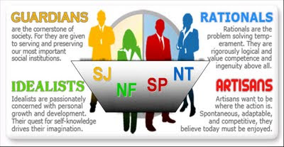
A word on Opposites
You probably think “well if everyone were like me, that would be great!” Possibly, but consider the following:
Our closest friends chances are, are like us. My closest friends are usually my temperament. By my romantic interests, like so many other people, are my opposite. When it comes to temperament, opposites do attract.

Slide 16
Opposites (cont)
The strengths of a Guardian are the weaknesses of an Artisan and vice versa. Where an Artisan is a risk taker and rebel, an Guardian may real them in and get them to think about their choices. Were a Guardian might overconcern themselves with right and wrong, an Artisan may motivate them to take a risk and think more induvial and less collectively.
It makes sense, we may want the world to be “just like me” but that would be rather monolithic and boring.
The problem comes from wanting to change an opposite into our way of being instead of embracing the variety and their individual traits that may compensate for our own weaknesses.

