Slide 1
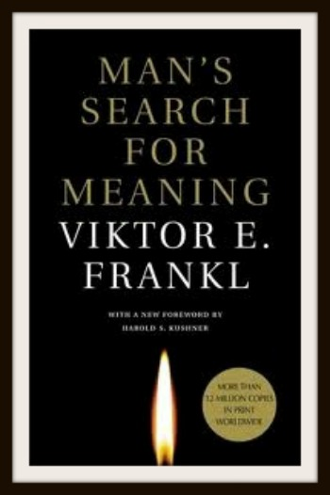
Man’s Search for Meaning by Viktor Frankl
Meeting each
First and Third Monday of every month
7:00 PM until completed
Presenter:
Larry Epstein LMHC CASAC

Slide 2
Dr. Viktor Frankl (1905-1997) is what’s known as an Existential Therapist. As a counselor I can’t think of any one other therapist who describes the biggest picture concerns we all experience; an “Existential Dilemma.” This is one that:
“…Is a moment at which an individual questions the very foundations of their life: whether this life has any meaning, purpose, or value. This issue of the meaning and purpose of existence is the topic of the philosophical school of existentialism.” – Wikipedia.

Slide 3
Frankl’s work borrowed much from Nietzsche and his work may be summarized with an understanding of the following of Nietzsche’s quotes: “Those who have a ‘why’ to live and bear with almost any ‘how’”
What does this mean? I can only speak for myself when I say that for those who go through life without direction or purpose (the foundation of most existential therapy is based on these concepts) dysfunction is soon to follow. For those who have a purpose and act upon it, a life to be lived, and a goal to be reached or accomplished, it is only a matter of time.

Slide 4
What is purpose?
What do you want to be when you grow up?
What do you want to do with your life?
This question, in my opinion, is short sighted. It implies that work is the point of our lives. It implies that through work we will accomplish all we want and need in life. It ignores all the other things life has to offer in our existence.
This may encompass work as well as travel, what one wants to know, what do you want your family to look like, where do you want to live, how important do you want to be and so many more questions to be pondered. For the person that can answer these questions will probably know existential happiness.

Slide 5
A little about Frankl
What makes Frankl amazing is that he doesn’t view the success of his book as an accomplishment, but as a testimonial to the problems humanity continues to face; a lack of individual purpose. His ideas were formulated as a result of his experiences in several Concentration Camps in the 1940s. There, amidst the suffering of peers and loss of his entire family save his sister, his ideas on purpose and meaning began to take shape. Despite the most tumultuous and downtrodden of circumstances one can face (and I admit, having been 4 of these facilities, I can’t think of too many situations that may be worse than living in a Concentration Camp) one can make meaning and indeed grow as a result of our experiences, no matter how positive or insufferable.

Slide 6
About Purpose
Purpose is intrinsically motivated. No one can tell another what their purpose is. Whether one labels it a calling, destiny, predetermination, divine inspiration, or a feeling, once one finds it, no one can take it away.
Purpose is neither good nor bad, right nor wrong. But if denied, either by will, circumstance, force, or uncertainty, dysfunction is soon to follow. In my profession, I work with may drug addicts. The hardest question to answer for many people on an assessment is “What do you want out of life?” It is my experience that few people can answer this question.

Slide 7
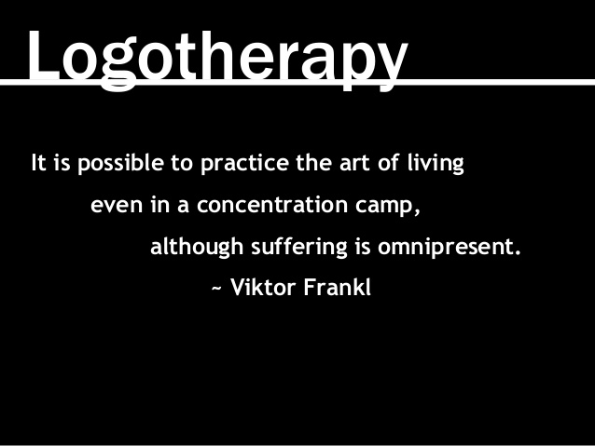
Suffering
To live life is to suffer and through suffering we find meaning. No one wants to suffer, no one wants to have bad things happen to oneself. Without suffering though we do not appreciate to “good” in our lives. Without suffering, we do not find what will push us to make a better today and tomorrow than what we experienced yesterday.

Slide 8
Suffering (continued)
The first half of Frankl’s book depicts his experiences in concentration camps. It is not a graphic depiction of his experiences, as these horrors are depicted in a multitude of other media.
He described how he suffered, lost everything down to each possession and almost every family member. He described how daily life had one purpose, to survive each day. He described the phases one goes through as many all but loses their humanity as apathy towards one’s own existence and the existence of others ceases to matter.

Slide 9
The question of choice:
The following is a paraphrase as I’m summarizing a rather long passage:
I may give the impression that the human being is nothing more than a reaction to his surroundings (the structure of camp life which forces a prisoner to conform to a conduct). But what of human liberty? Is there no freedom to or spiritual liberty for one to choose his reactions to his surroundings? Is that theory true that man is nothing more than a product of his conditional and environmental factors of a biological, psychological and sociological nature? What’s more, does it prove that in the concentration camp, one cannot escape the influences of his surroundings? Does one have no choice in the face of such circumstances?

Slide 10
The questions of choice: (continued)
These questions can be answered both on principle and experience. Man does have a choice. There were ample examples that apathy can be overcome and irritability suppressed. Man can preserve an outlet of spiritual freedom and freedom expressed even in such examples of physical and psychological stress.
We who lived in the huts can remember the men who walked in the huts, comforting others, giving away their last piece of bread. They may be few in number, but they offer sufficient proof that everything can be taken from a man but one thing; the ability to choose one’s attitudes in any set of circumstances, the freedom to choose one’s own way.

Slide 11
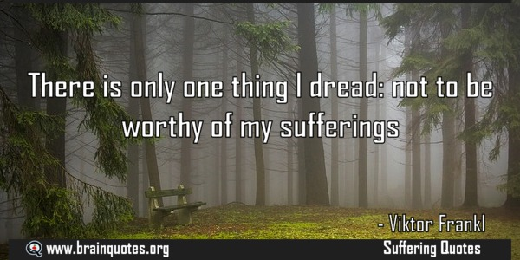
Suffering
The quote you see is attributed to Dostoyevsky. Frankl considered that those who died bore witness to this axiom: they suffered as an expression of their freedom, a freedom they chose not to lose. In experiencing their suffering, they brought meaning to their lives and gave it purpose.

Slide 12
Suffering: (cont)
Suffering is part of life. If we assume that all parts of life have meaning, and that part of life is to suffer, than it follows that there is meaning in suffering. “without suffering and death, human life cannot be complete.”
Frankl continues, stating that the way one faces their suffering adds a deeper meaning to one’s life. One chooses to retain one’s dignity and “humanity” or reduce oneself to being animalistic and simply responding to his or her own environment. In doing so, one becomes worthy of his or her own suffering.

Slide 13
On suffering and purpose
Frankl is clear to point out that few people made a choice not to simply be a response to their environment. He stated that the majority of people fell into apathy and despair. He equates that those who did not continued to have a purpose, to live in the moment and look to the future, retaining hope that eventually things will change. Those that could do this, noticed opportunities in camp life and allowed them to grow spiritually beyond their circumstances.
Those that did not, did not take their lives seriously, and “despised it as something of no consequence. They preferred to close their eyes, and live in the past. Life for such people became meaningless.”

Slide 14
Summary
Frankl’s work can be summarized in the following ways:
The meaning of life is to suffer
Through suffering we find and express meaning and purpose
Without suffering, we do not appreciate the good in our lives
Suffering is part of life, and despite not wanting to suffer, if we do not, we are not living our lives.
One should embrace their suffering.
One who finds their purpose in life, their “why” can deal with almost any “how.”

