Slide 1
Meetup: Improving Relationships
Meeting each
First and Third Monday of every month
6:30 PM until completed
Presenter:
Larry Epstein LMHC CASAC

Slide 2
Informed consent
These sessions are designed to encourage dialogue between members. However as someone who is a mandated reporter, I MUST by local, state, and federal regulation report to the proper authorities any suspected incidences of child abuse, self-harm, potential harm from another of anyone present, or any intent to harm others not present.

Slide 3
So what are we doing here? What do you want this group to be?
(this is where you start participating)

Slide 4
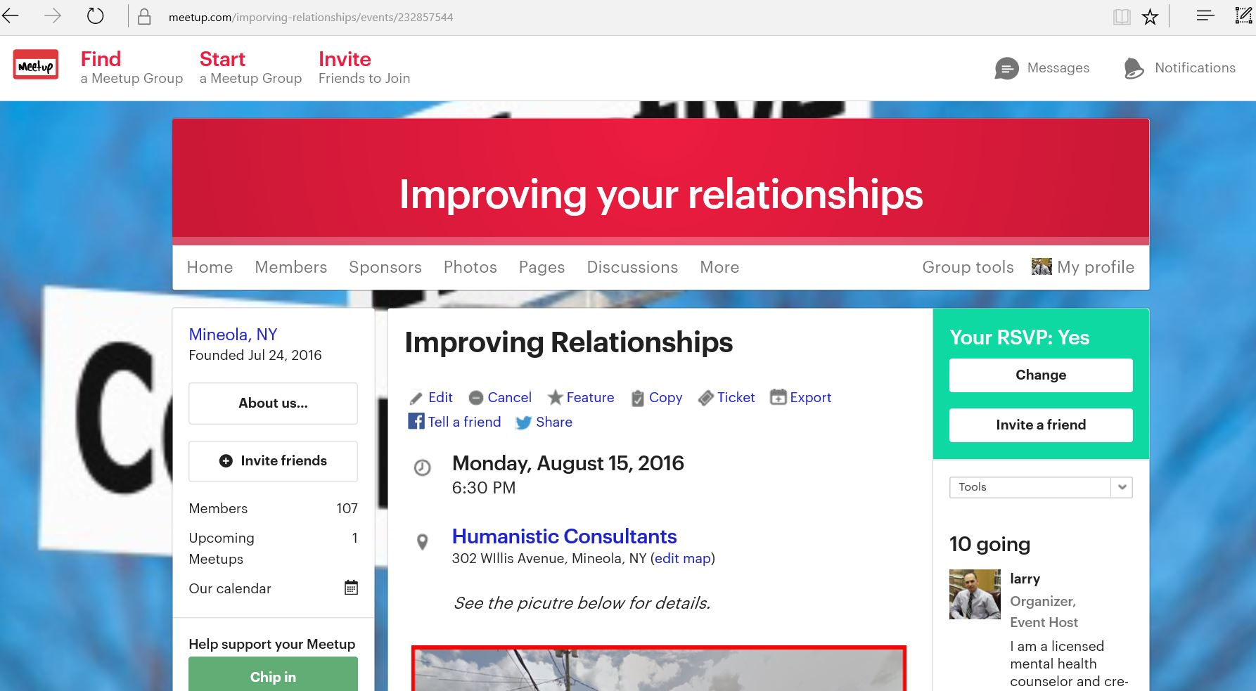
Hopefully we are here for this…to improve our relationships

Slide 5
What does it mean to communicate?
Effective:
Adequate to accomplish a purpose; producing the intended or expected result:
Communication:
The imparting or interchange of thoughts, opinions, or information by speech, writing, or signs.

Slide 6
What type of communication are many people used to?
Dysfunctional:
Not performing normally, as an organ or structure of the body; malfunctioning.

Slide 7
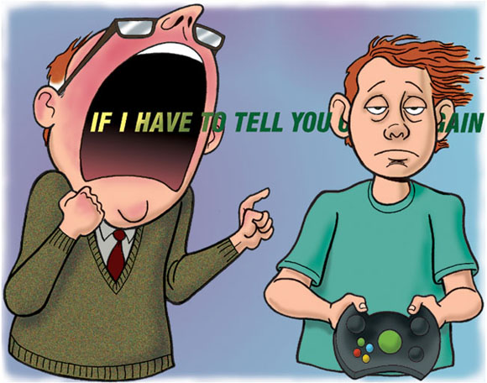
What are some examples of effective communication?
What are some examples of dysfunctional communication you’ve either seen or witnessed?

Slide 8
The work of Dr. John Gottman Ph.D.
His website www.Gottman.com emphasizes his many achievements:
John Gottman has conducted 40 years of breakthrough research with thousands of couples. His work on marriage and parenting has earned him numerous major awards
Dr. Gottman was one of the Top 10 Most Influential Therapists of the past quarter-century by the Psychotherapy Networker. He is the author or co-author of over 200 published academic articles and more than 40 books
He is Professor Emeritus of Psychology at the University of Washington, where he founded ”The Love Lab” at which much of his research on couples’ interactions was conducted.

Slide 9
The Love Lab and the predictability of divorce
Dr. Gottman’s research enables him to predict with 91% accuracy whether a couple will remain married or end in divorce.
He can do this listening to them for 5 minutes.
Not arguing, not fighting, not name-calling…talking.

Slide 10
This meetup is not entirely about intimate relationships, but also friendships, professional, and casual relationships.
Because of Dr. Gottman, all relationships can be seen through the lenses of his work, and predict the likelihood others will want to continue associating with you and me, in all types of environments.

Slide 11
Dysfunction according to Dr. Gottman

Slide 12
There are 6 “Signs of the Apocalypse” in any relationship. I’ll be focusing on the second one, the four horsemen. For more detail on the other signs, see any of his books, his official site www.Gottman.com, or many professional and self help books that refer back to his research.

Slide 13
Horseman #1
Criticism:
A global insult to a person. Where a complaint about someone addresses that specific event or trait (“We agreed that it was your turn to wash the dishes, it hurts me that they are still there”), a criticism attacks a person’s character.
To turn a complaint into a criticism, just add…
“Why are you so forgetful…”
“You don’t seem to care about me…”
“I hate it when you…”
Or any variant…what’s one you are familiar with?

Slide 14
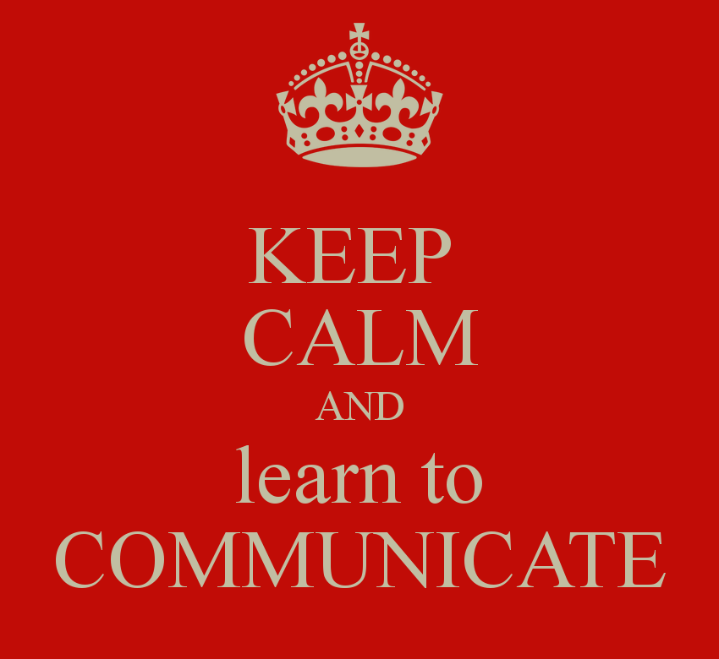
Where do we learn to criticize others?
Criticism increases the likelihood of the far more damaging…Horseman #2

Slide 15
Horseman #2
Contempt:
Dr. Gottman states “the worst of the horsemen-(it) is poisonous to relationships because it conveys disgust. It is virtually impossible to resolve a problem when your partner is getting the message you’re disgusted with him or her. Inevitably, contempt leads to more conflict rather than reconciliation.”

Slide 16
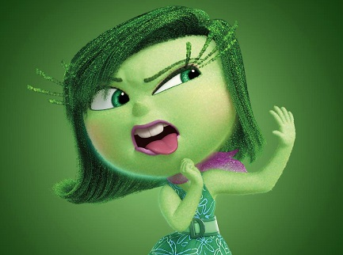
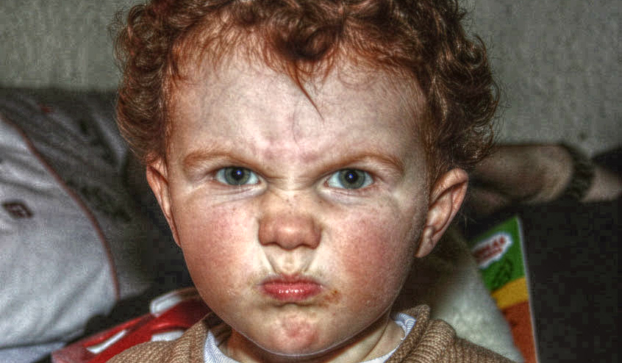
Examples:
Sarcasm
Cynicism
Name calling
Eye rolling
Sneering
Mockery
Hostile humor

Slide 17
So who can relate?
Who has a contempt story?

Slide 18
Horseman #3
Defensiveness:
Instead of backing down, admitting fault, or looking for compromise, it is nearly expected one would want to defend his or her actions.
Gottman says:
“Although it is understandable that one would want to defend (them)selves, research shows that this approach rarely has the desired effect… this is because defensiveness is really a way of blaming (the other person).”

Slide 19
But shouldn’t I defend myself?
At the heart of defensiveness, the underlying message is “the problem isn’t me, it’s you.”
This leads to escalation.
And if you think that’s not a big deal, please see…
The Middle East Epic Rap Battles of History
Married with Children Your neighbors that won’t stop yelling

Slide 20
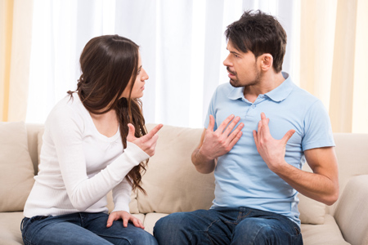
So who has a defensiveness tale to tell?

Slide 21
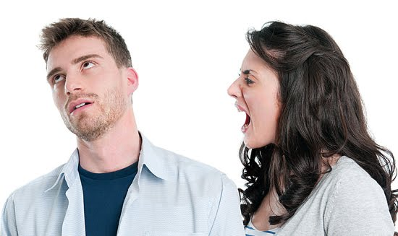
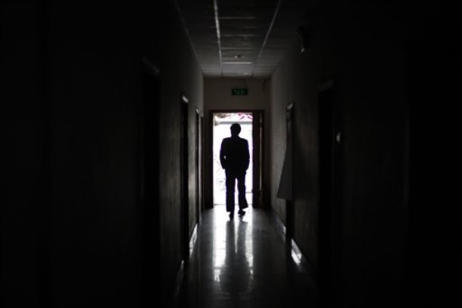
Horseman #4 (men…looking at you)
Stonewalling:
A disengaging from the conversation as seen by physical body language, putting objects between yourself and the other person, physically removing oneself from the room, or simply not participating in the discussion. It’s like talking to a stone wall.

Slide 22
Or worse….(women, feel free to affirm this…)
“uh-huh”
“yeah”
Silence
This is the case of “the more I yell, the less he (or she) seems to care.” Minimal if any feedback is displayed and one person feels neglected and/or ignored.
It’s not that men only do this, but it is considered a masculine trait, usually justified by “if you have nothing nice to say, say nothing at all.”

Slide 23
Any thoughts on stonewalling?

Slide 24
What do I do if these “four Horsemen” don’t work for me?
Does anyone know what “good” or “effective” communication looks like? Does anyone know any examples of any couples, friends, colleagues, or families (really any relationship between 2 or more people) that that communicate “effectively?”

Slide 25
The “Speaker-Listener” technique

Slide 26
A note on safety
None of what we’ll be discussing matters if you are not safe. There are some people that simply will not respond to this or any attempts to communicate effectively. If you feel that using any or all techniques discussed may result in escalation (e.g., “I know this will only make things worse”) then your safety trumps any form of communication.
Please consider your safety before engaging in conversation with individuals that you are aware are easy to anger, aggressive, volatile, or have a history of making threatening behaviors or using threatening words. If you must do so, have an exit strategy.

Slide 27
Rules to Speaker-Listener (in no particular order)
The person who speaks keeps it short, do not go on and on and on…
One subject at a time
Do NOT bring up past transgressions, talk about the present
Talk about yourself using “I” statements as opposed to “you”
If now is not a good time, arrange a time that the subject can be discussed
Let the other talk once you have made your point
Each person gets the others FULL attention. Turn off the electronics, face one another, put distractions out of your mind and if possible, presence

Slide 28
Rules to Speaker-Listener (in no particular order)
One person speaks at a time (To LISTEN, one must be SILENT)
The listener has to let the speaker know he or she has been heard. It is not time to retort, defend, or discount their words
Paraphrase; start responses with:
It sounds like you are saying…
I just want to be clear, you mean…
To be clear, you said…
I think you mean … right?
So you are saying … yes?

Slide 29
Listener, continued
Whether you agree or disagree is not important. Again, you are not defending yourself, just affirming to the other person “I heard you.”
You are on the same team, it is not a competition.
Clarifying statements should not be word for word repeats of what the speaker said if possible. Your body language and tone of voice are EXTREMELY important.
“You are you saying…right” can either be a paraphrase or an interrogation based on tone of voice and body language. One way conveys concern, the other is an attack, contempt.

Slide 30
Switching roles
Once the speaker affirms they have said what needs to be said or the listener feels they need to say something, the roles switch. A motion like raising your hand is usually enough. If not you can use:
“Can I talk now?”
“So what you’re saying is …. Can I speak?”
“I would like to say something if that’s ok.”
Find what works for you.

Slide 31
Why is this technique uncomfortable for me?
Many people report being uncomfortable with Speaker-Listener techniques…at first.
Like any new skill, until you practice, it will seem uncomfortable.
Lets face it, this isn’t passionate, it’s not exciting, it’s not emotionally charged.
It’s probably also not what we witnessed parents doing growing up.
It’s not what we see on TV.
It’s not how people in authority communicate.
We may be used to defending ourselves or offending others.

Slide 32
If you think this will always be awkward…
Think back throughout this meetup.
Did you see any examples of the host using this technique today?
Did it appear natural or awkward?

Slide 33
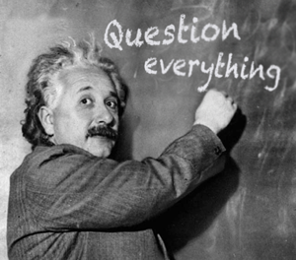
ANY QUESTIONS?

Slide 34
Credits:
The works of Dr. John Gottman can be found at https://www.gottman.com/
All pictures found in this presentation were obtained from searches on Google.com
All definitions were obtained from Dictionary.com

